Slide 1
Project: Pattern Recognition - using image processing library OpenCV
Dawit Woldemichael (19819)
Professor Henry Chang

Slide 2
Table of Contents
Introduction
Design
Noise Reduction
Histogram
Thresholding
Pattern Recognition
Implementation
Python Code
Testing
Enhancement Ideas
Conclusion
Bibliography / References

Slide 3
Introduction
This technical report outlines the process of pattern recognition using image processing techniques. The main goal of this process is to distinguish and classify objects within an image. The report covers the design and implementation of key steps involved in the pattern recognition process, including noise reduction, histogram analysis, thresholding, connectivity analysis, and pattern recognition itself.

Slide 4
Design
Noise Reduction by Blurring
Noise reduction through blurring is performed to enhance the distinction between object edges in the image. Moreover, The noise reduction step aims to improve the subsequent stages of the pattern recognition process.
Histogram
The histogram is utilized to determine the threshold value required for subsequent thresholding. The OpenCV library is used for this purpose. A sample code in Python will be presented to compute and plot the histogram of the input image.

Slide 5
Design… cont’d
Thresholding
Thresholding is crucial for converting a grayscale image into a binary image. Two methods for thresholding are explained: global thresholding and Otsu's thresholding. The latter iterates through potential threshold values to minimize the sum of foreground and background spreads. Code snippets are provided for thresholding using various techniques, including Gaussian filtering.
THRESH_BINARY
THRESH_OTSU: uses the Otsu algorithm to choose the optimal threshold value

Slide 6
Design… cont’d
Pattern Recognition
Pattern recognition involves identifying and classifying objects in the image. This step is implemented using the openCV library. The process includes finding contours, approximating shapes, and classifying them based on the number of sides. The code also demonstrates how to display the recognized shapes and their names on the image.

Slide 7
Implementation
Python Code
import cv2
import numpy as np
from matplotlib import pyplot as plt
# Load the image
img = cv2.imread('images/pattern.jpeg')
gray_img = cv2.cvtColor(img, cv2.COLOR_BGR2GRAY)
# Apply Gaussian blur to remove salt and pepper noises
filtered_image = cv2.GaussianBlur(gray_img, (5, 5), 0)
# Display noisy and filtered images
plt.subplot(1, 2, 1), plt.imshow(gray_img, cmap='gray')
plt.title('Noisy Image'), plt.xticks([]), plt.yticks([])
plt.subplot(1, 2, 2), plt.imshow(filtered_image, cmap='gray')
plt.title('Filtered Image'), plt.xticks([]), plt.yticks([])
# Save filtered image
# cv2.imwrite('filtered_image.jpg', filtered_image)
plt.show()

Slide 8
Implementation… cont’d
Python Code
# Global thresholding
ret1, th1 = cv2.threshold(img, 127, 255, cv2.THRESH_BINARY)
# Otsu's thresholding
ret2, th2 = cv2.threshold(gray_img, 0, 255, cv2.THRESH_BINARY + cv2.THRESH_OTSU)
# Otsu's thresholding after Gaussian filtering
ret3, th3 = cv2.threshold(filtered_image, 0, 255, cv2.THRESH_BINARY + cv2.THRESH_OTSU)
# plot all the images and their histograms
images = [img, 0, th1, gray_img, 0, th2, filtered_image, 0, th3]
titles = ['Original Noisy Image', 'Histogram', 'Global Thresholding (v=127)',
'Original Noisy Image', 'Histogram', "Otsu's Thresholding",
'Gaussian filtered Image', 'Histogram', "Otsu's Thresholding"]
for i in range(3):
plt.subplot(3, 3, i*3+1), plt.imshow(images[i*3], 'gray')
plt.title(titles[i*3]), plt.xticks([]), plt.yticks([])
plt.subplot(3, 3, i*3+2), plt.hist(images[i*3].ravel(), 256)
plt.title(titles[i*3+1]), plt.xticks([]), plt.yticks([])
plt.subplot(3, 3, i*3+3), plt.imshow(images[i*3+2], 'gray')
plt.title(titles[i*3+2]), plt.xticks([]), plt.yticks([])

Slide 9
Implementation… cont’d
Python Code
plt.show()
# Connectivity Analysis
def connected_component_label(path):
# Getting the input image
img = cv2.imread('pattern.jpg', 0)
# Converting those pixels with values 1-127 to 0 and others to 1
img = cv2.threshold(gray_img, 127, 255, cv2.THRESH_BINARY)[1]
# Applying cv2.connectedComponents()
num_labels, labels = cv2.connectedComponents(img)
# Map component labels to hue val, 0-179 is the hue range in OpenCV
label_hue = np.uint8(179*labels/np.max(labels))
blank_ch = 255*np.ones_like(label_hue)
labeled_img = cv2.merge([label_hue, blank_ch, blank_ch])
# Converting cvt to BGR
labeled_img = cv2.cvtColor(labeled_img, cv2.COLOR_HSV2BGR)
# set bg label to black
labeled_img[label_hue==0] = 0
#Showing Image after Component Labeling
plt.imshow(cv2.cvtColor(labeled_img, cv2.COLOR_BGR2RGB))
plt.axis('off')
plt.title("Image after Component Labeling")
plt.show()

Slide 10
Implementation… cont’d
Python Code
connected_component_label(filtered_image)
# Pattern Recognition (Recognizing the type of Objects in the image)
font = cv2.FONT_HERSHEY_COMPLEX
_, threshold = cv2.threshold(filtered_image, 0, 255, cv2.THRESH_BINARY + cv2.THRESH_OTSU)
contours, _ = cv2.findContours(threshold, cv2.RETR_TREE, cv2.CHAIN_APPROX_SIMPLE)
for cnt in contours:
approx = cv2.approxPolyDP(cnt, 0.01 * cv2.arcLength(cnt, True), True)
cv2.drawContours(img, [approx], 0, (0), 5)
x = approx.ravel()[0]
y = approx.ravel()[1]
if len(approx) == 4:
cv2.putText(img, "Square", (x, y), font, 1, (255))
else:
cv2.putText(img, "Circle", (x, y), font, 1, (255))
cv2.drawContours(img, contours, -1, (255, 0, 0), 2)
cv2.imshow("Pattern recognition", img)
cv2.waitKey(0)
cv2.destroyAllWindows()

Slide 11
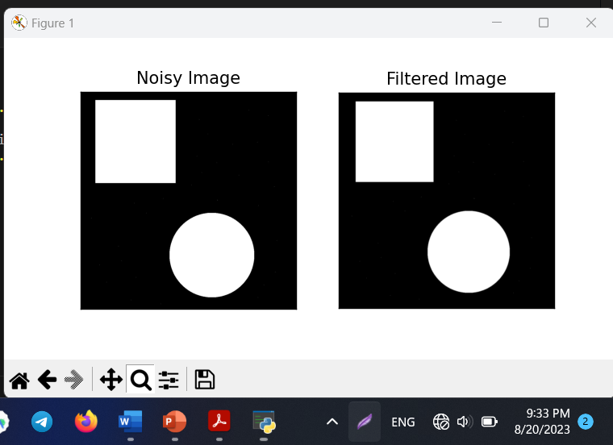
Testing
The entire process is tested using sample images to verify the effectiveness of noise reduction, thresholding, connectivity analysis, and pattern recognition.

Slide 12
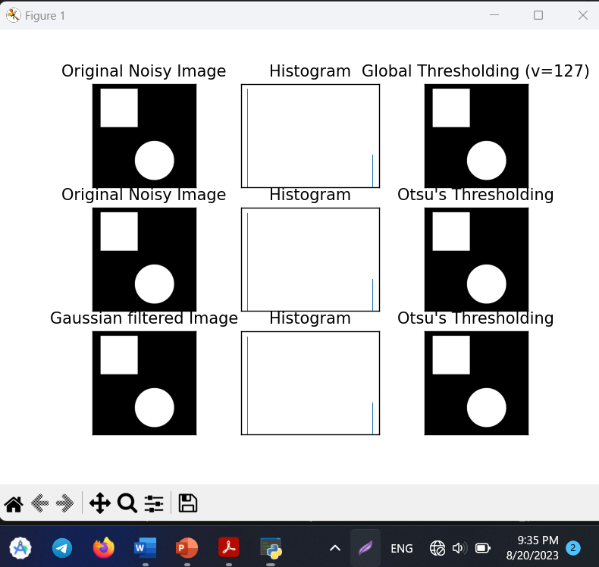
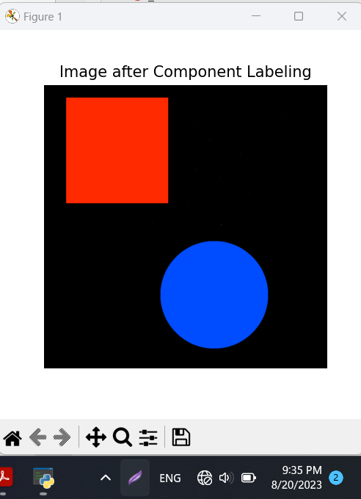
Test… cont’d

Slide 13
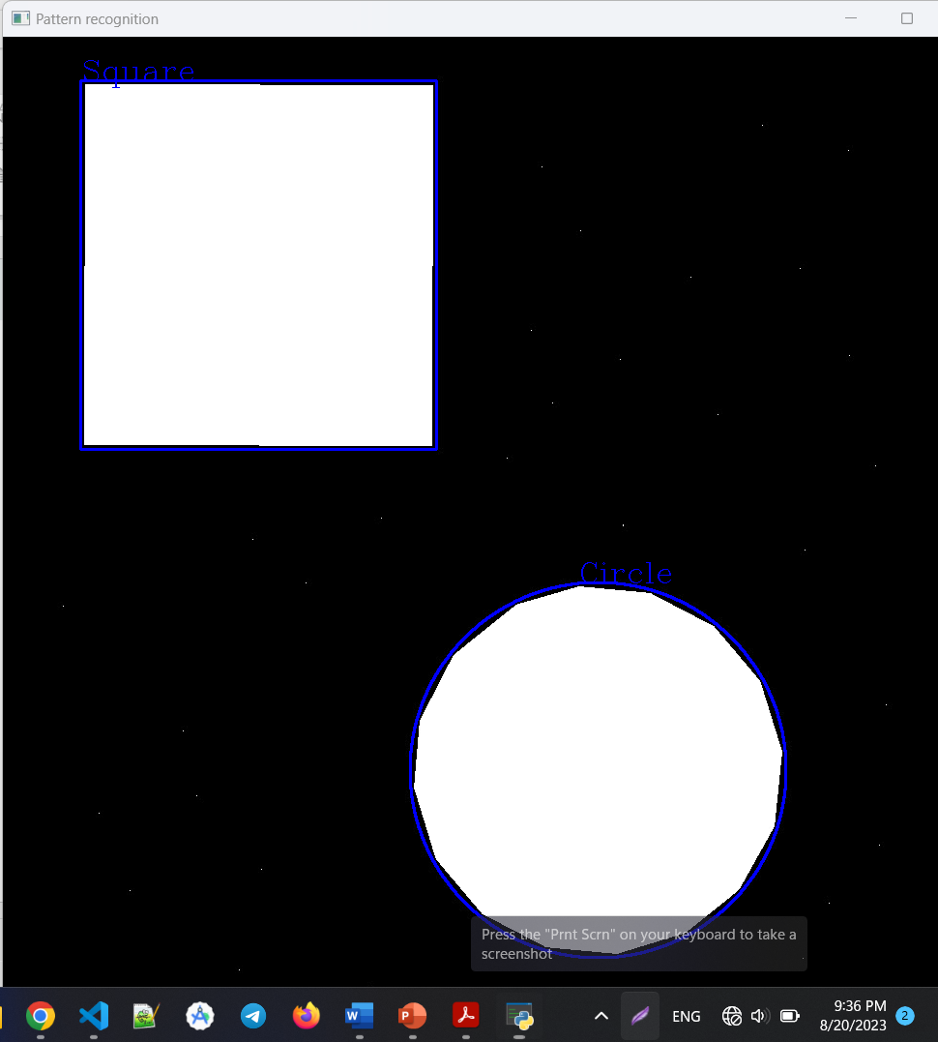
Test… cont’d

Slide 14
Enhancement Ideas
Possible enhancements include:
Implementing advanced noise reduction techniques.
Experimenting with various thresholding methods for improved object segmentation.
Exploring shape recognition techniques beyond basic geometries.

Slide 15
Conclusion
The pattern recognition process involves several key steps, including noise reduction, histogram analysis, thresholding, connectivity analysis, and pattern recognition. Each step contributes to the accurate identification and classification of objects within an image. The implementation and testing of these steps demonstrate their importance in image processing applications.

Slide 16
References
Open CV Documentation
https://docs.opencv.org/
Mikaela Montaos's OpenCV code
https://hc.labnet.sfbu.edu/~henry/sfbu/course/image/pattern_recog/hw/2020_fall/Mikaela_Montaos_python_OpenCV.pdf

